Slide 1

Wasay Emily Wang Yasemin Mike Sowmya
Final presentation

Slide 2
Overview
Wasay Emily Wang Yasemin Mike Sowmya
Brief Introduction and Background
Evolution : A brief lifecycle of the project
Implementation details:
Framework
Search Function
Image Management
CSS
Testing and Quality Assurance
Conclusion
Stats
Lessons Learnt
Questions

Slide 3
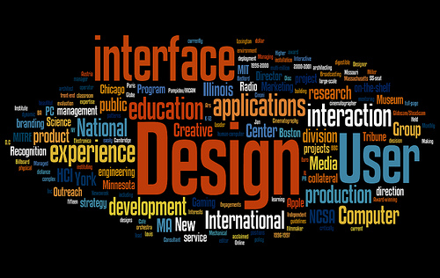
Motivation
Wasay Emily Wang Yasemin Mike Sowmya
With the introduction of mobile devices and improvement in internet speed and bandwidth, Web-based applications are the future and the present too .
Multi Enviorment Programming …
Provided interesting learning and collaboration opportunities.
A new take on already existing set of applications and websites

Slide 4
Brief Introduction
Wasay Emily Wang Yasemin Mike Sowmya
A web-based real estate application
PHP based framework
Monopoly themed
MVC architecture
Fully provided with the CRUD functionality for User, property and Image classes

Slide 5
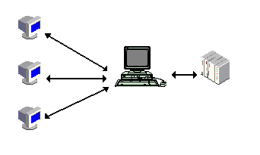
So Here is how it works …
Wasay Emily Wang Yasemin Mike Sowmya
1. Client Side:
The web-application’s display interacts with the user’s input and sends a request to the Web-server
2. Server Side:
Provides the requested service by using the database if reqired
Client-server architecture
3. Client Side:
Displays the result or the altered display

Slide 6
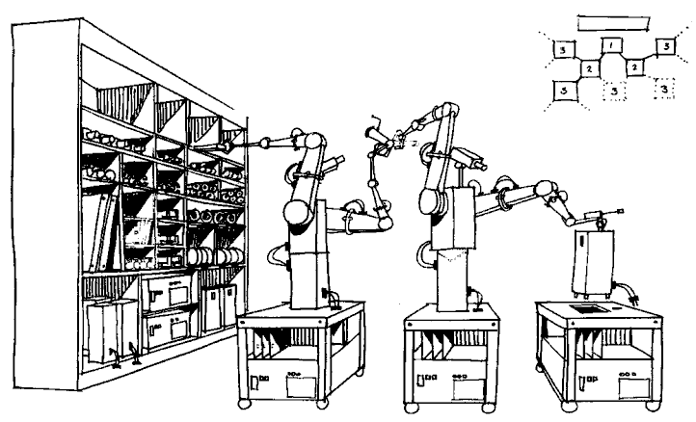
Create Read Update Delete
Wasay Emily Wang Yasemin Mike Sowmya

Slide 7


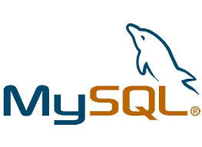





Technology Used
Wasay Emily Wang Yasemin Mike Sowmya

Slide 8
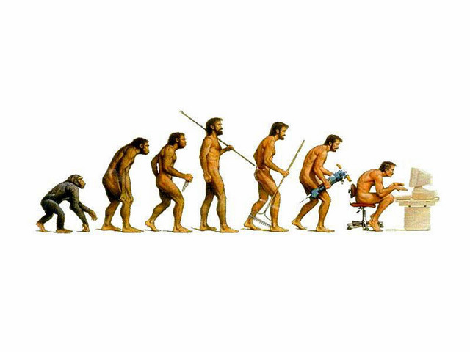
Evolution
Wasay Emily Wang Yasemin Mike Sowmya
Lifecycle of the project and its management

Slide 9

The Big Bang …
Wasay Emily Wang Yasemin Mike Sowmya
Decided to take the course (Finally)
Had to do a project
In a group :/
Made a group

Slide 10






Our Team
Wasay Emily Wang Yasemin Mike Sowmya
We are the WORLD …
Team with diverse experiences, nationalities and backgrounds
Provided us with the opportunity to learn about each others skills, work ethics as well as cultures and life in general.
On average little or no prior web development experience

Slide 11
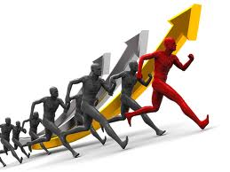
Our Challenges
Wasay Emily Wang Yasemin Mike Sowmya
New Technology
Time Management
Consensus
Risk Management
Team Size

Slide 12

The Approach
Wasay Emily Wang Yasemin Mike Sowmya
In General:
Consensus
Collaboration
Enhance learning
Project Management:
Assign leadership roles to members
Regular meetings
Iterative and incremental

Slide 13
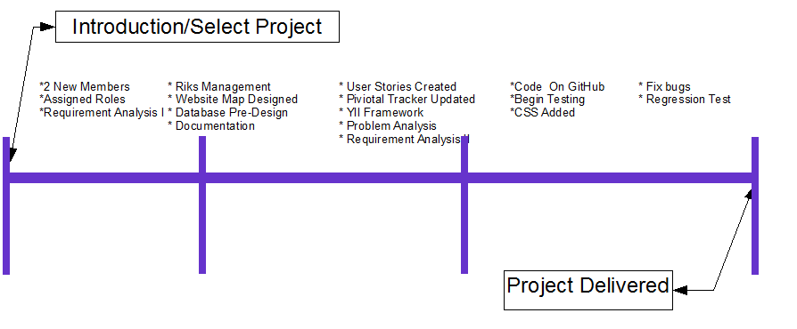
Wasay Emily Wang Yasemin Mike Sowmya
Evolution per Iteration

Slide 14
Implementation Details

Slide 15
Overview
Wasay Emily Wang Yasemin Mike Sowmya
Framework and model
Search Function
Image Management
Database

Slide 16
Software Architecture
Model – View – Controller Architecture
Yii Php framework
Twitter bootstrap front end framework

Slide 17
Model
Data manipulation
Database connection
Validation

Slide 18
Model
User entity
Email (require, unique)
Name (require)
Password (require)
Password_repeat (require)
Method Inherited from CModel(Framework)

Slide 19
Model
House
String: Title (required)
String: Address_1 (required)
String: Address_2
String: City (required)
String: State (required)
Integer: Zipcode (required)
Text: Description (required)

Slide 20
Model
House
Integer: number of floor
Integer: number of bathroom
Integer: number of room
Integer: Garage
Integer: Garden

Slide 21
Model
Image
Image url
House id

Slide 22
View
User
_form.php: hold the form for update and create user
Create.php: interface for create user
View.php: interface for view one user given the user id
Setting.php: interface for manager user
Update.php: interface for update user attribute;

Slide 23
View
House
_form.php: hold the form for update and create user
Create.php: interface for create house
View.php: interface for view one house given the house id
index.php: interface for view all house
update.php: interface for update house

Slide 24
View
Site
Index.php: interface of homepage
Login.php: interface for login

Slide 25
Controller
Interact between Model and View
User Authentication and authorization

Slide 26
Validation
Back end: Model
Front end: Ajax, JQuery

Slide 27
Database Implementation
Table:
User: map to user class
House: map to house class
Image: map to image class
Seller:
hold foreign key house id and user id
Table build associate between user and house
Authitem: hold business rule for role access based control
Authassignment: map the role to user

Slide 28
Database Implementation
Seller
Has foreign key reference to house table
On delete cascade
On update cascade
Has foreign key reference to users table
On delete cascade
On update cascade

Slide 29
Database Implementation
Image
Has foreign key reference to house table
On delete cascade
On update cascade

Slide 30
Implementation
User can not delete user
Only admin can delete user
Admin then delete house reference user
User can only delete and update his house and his profile
Anyone can view house information

Slide 31
Search Functionality
Wasay Emily Wang Yasemin Mike Sowmya

Slide 32
Function provided
Wasay Emily Wang Yasemin Mike Sowmya
Search by :
City
Zip
Free mode
Return the image and brief details of the houses that match the criteria
Further linked to the original page

Slide 33
How it works …
Wasay Emily Wang Yasemin Mike Sowmya
Not provided by the framework, had to be custom built
Coded in PHP and linked to the DB using MYSQLI
4. Execute the select statement and display the results
Take Input
Get input string from the user
2. Submit to search page
3. Formulate select statement based on the parameter searched by
4. Execute the statement, pool through results and by using PHP statements select the relevant ones

Slide 34

Some Code …
Wasay Emily Wang Yasemin Mike Sowmya

Slide 35
User management/ Authentication
Wasay Emily Wang Yasemin Mike Sowmya

Slide 36
User Management/Authentication
Wasay Emily Wang Yasemin Mike Sowmya
Two type of users
Browsers
Sellers
Login
User Management Page
Change password
View House Postings
Edit
delete

Slide 37
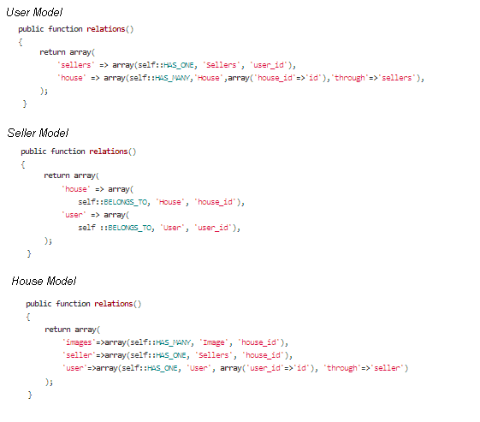
AR relational queries
Wasay Emily Wang Yasemin Mike Sowmya
Behind user management of house postings
BELONGS_TO:
if the relationship between table A and B is one-to-many, then B belongs to A (e.g. House belongs to Seller);
HAS_MANY:
if the relationship between table A and B is one-to-many, then A has many B (e.g. User has many House);
HAS_ONE:
this is special case of HAS_MANY where A has at most one B (e.g. House has at most one Seller);

Slide 38
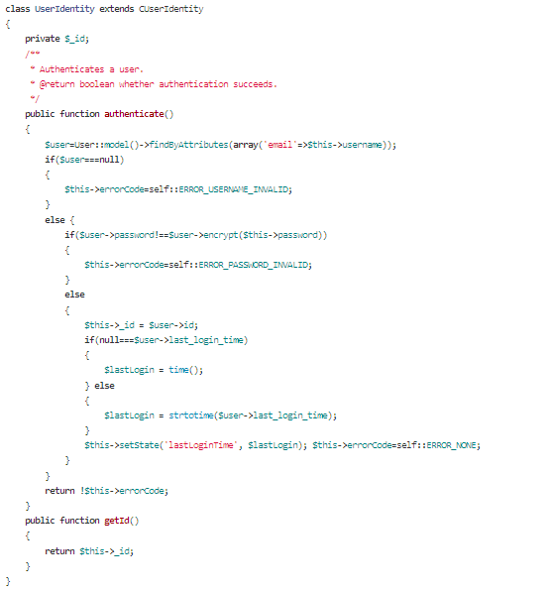
Yii Authentication via Database
Wasay Emily Wang Yasemin Mike Sowmya
UserIdentity represents the data needed to identify a user
The UserId class contains the authentication method that checks if the provided data can identify the user
Yii has a built in AuthManger requires configuration
implement the authenticate() method to use the database to validate credentials.
Overrode the CUserIdentity::getId() method to return the _id property because the default implementation returned the username as the ID.
Update controller to identify user authentication.

Slide 39
Image Management
Wasay Emily Wang Yasemin Mike Sowmya

Slide 40


Wasay Emily Wang Yasemin Mike Sowmya
Image Management
A Seller can ONLY upload valid image files from The House Update Page
On UPLOAD the actionCreate() from the Image Controller is invoked
Inside of actionCreate() the image is sent to our Cloudinary Account
The Image Model is Updated with The Image URL & HouseID
After upload A Seller can Delete the Image from the Image Table

Slide 41

Wasay Emily Wang Yasemin Mike Sowmya
Image Management
PHP framework:
Cloudinary.php
Settings.php
Uploader.php

Slide 42
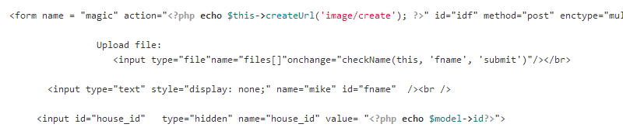
Wasay Emily Wang Yasemin Mike Sowmya
Image Management
1. User Uploads from House Update page

Slide 43

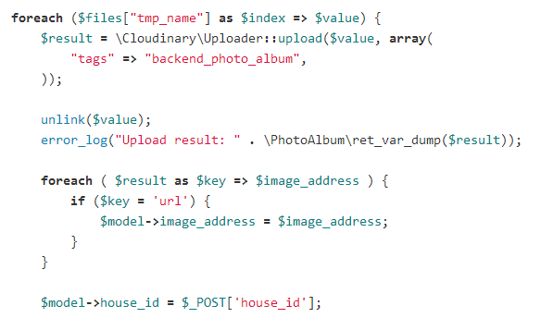
Wasay Emily Wang Yasemin Mike Sowmya
Image Management
2. Controller invokes actionCreate()

Slide 44
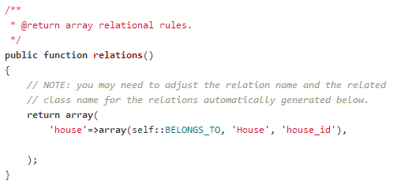
Wasay Emily Wang Yasemin Mike Sowmya
Image Management
3. Image Model defines relations()

Slide 45
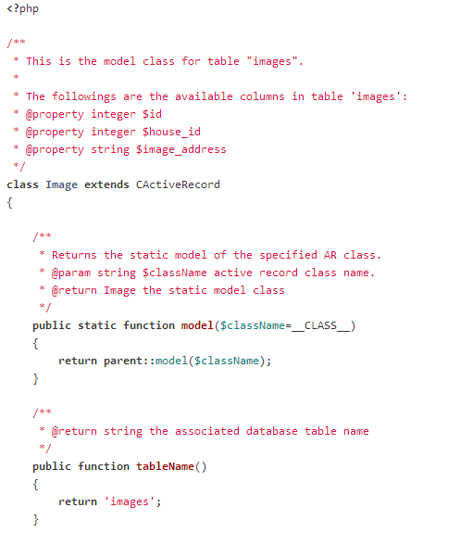
Wasay Emily Wang Yasemin Mike Sowmya
Image Management
Define an Image Model:
CActiveRecord is the base class for classes representing relational data.
It implements the active record design pattern, a popular Object-Relational Mapping (ORM) technique.

Slide 46
CSS and styling
Wasay Emily Wang Yasemin Mike Sowmya

Slide 47
What is CSS?
Wasay Emily Wang Yasemin Mike Sowmya
CSS stands for Cascading Style Sheets
Styles define how to display (X)HTML elements
Styles are normally stored in Style Sheets
Multiple style definitions will cascade into one

Slide 48
Why to use Styles?
Wasay Emily Wang Yasemin Mike Sowmya
Documents written with CSS are
more flexible
short
clear
Basic formating tool
Easy multiple document managment
Save time by using selector classes
New opportunities in formating
Webpage
Structure
Style-formatting
(X)HTML
CSS

Slide 49
What is Bootstrap?
Wasay Emily Wang Yasemin Mike Sowmya
UI framework (set of JavaScript, CSS, and images )
Open Source project
Supports HTML5 and CSS3
Supported by all major browser (even IE7)
Released in August 2011

Slide 50
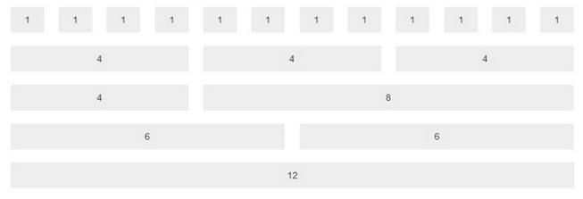
Bootstrap Features
Wasay Emily Wang Yasemin Mike Sowmya
Grid System

Slide 51
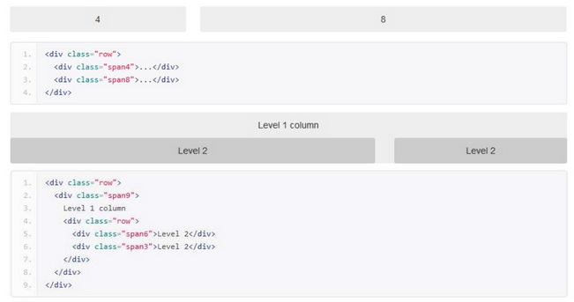
EXAMPLE
Wasay Emily Wang Yasemin Mike Sowmya

Slide 52
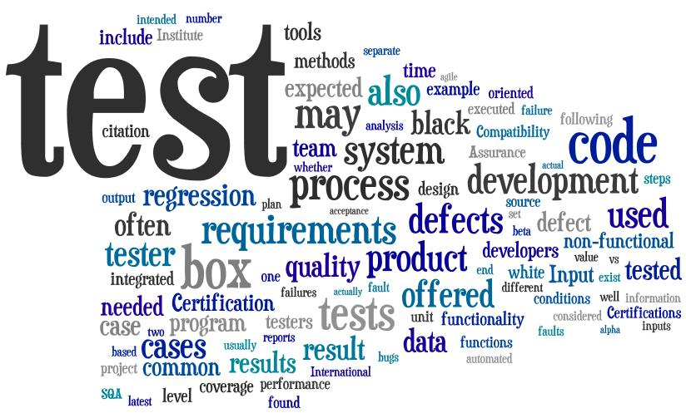
Wasay Emily Wang Yasemin Mike Sowmya

Slide 53
Testing
Wasay Emily Wang Yasemin Mike Sowmya
Software Testing is a process of verifying and validating that the product meet the requirements.
Testing Types:
Unit testing.
Component testing.
Integration testing.
System testing.
Regression testing.

Slide 54
Unit Testing
Wasay Emily Wang Yasemin Mike Sowmya
Unit testing is a method where the individual units of source code are tested to make sure each of them works fine.
PHP Unit.
PHP unit testing procedures are similar to Java Unit testing, where each block/function of the code is tested
PHP unit also provide us with the opportunity to test the code coverage …

Slide 55
Component Testing
Wasay Emily Wang Yasemin Mike Sowmya
Each implemented component of the website was tested.
How?
- Selenium

Slide 56
Integration Testing
Wasay Emily Wang Yasemin Mike Sowmya
Integration testing is the phase in which individual software modules are combined and tested as a group.
How we did it?

Slide 57
System Testing
Wasay Emily Wang Yasemin Mike Sowmya
System testing of is conducted on a complete, integrated system to evaluate the system’s compliance with its specified requirements.
Techniques used:
Black box testing.
Domain testing for SignUp page.
Variables are Name, Password and email.
Boundary values
Name: valid: 1, 32 Invalid: -1, 33
Password: valid: 1, 8 Invalid: <1, >8.
Email : beyond the standard format.

Slide 58
Test Case Template
Wasay Emily Wang Yasemin Mike Sowmya
Test case ID: | TID1
Test items: | Signup - Username
Test priority : | Medium
Dependencies : | No
Preconditions: | Website Search Page.
input data: | Username: Dammy User email: dam_123@gmail.com User_password:12345678
Test steps: | Step1: Open Webpage Step2:Click on Signup button Step3: Fill in the Username, User email, Password, Password repeat and then click on create button.
Post conditions: | User should be able to login
Expected output: | Create User and Redirect to Login Page.
Actual output: | Create User and Redirect to Login Page.
Pass or Fail: | Pass
Bug id/link:
Additional notes:
Is Regression | Yes
Regression Result | Fail
Regression Bug id/link. | #24 https://github.com/cs673p1/cs673p1/issues/24

Slide 59
Tools Used?
Wasay Emily Wang Yasemin Mike Sowmya
Selenium:
Selenium is a portable software framework for web applications.
Provides a record or play back tool.
It is a plugin to Firefox.
It is freely available on the internet.

Slide 60
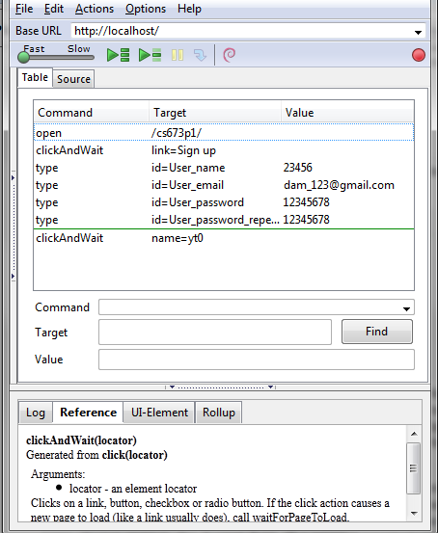
Test Scripts by Selenium
Wasay Emily Wang Yasemin Mike Sowmya
Command: Displays the command for the currently selected component
Target: It is used to identify web elements on the web page. There different ways of locating web elements for example locating by ID, locating by hyperlink, locating by CSS3 etc.
Value: field where each input values for the web elements are stored in here.

Slide 61
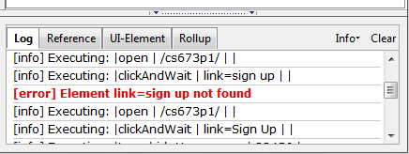
Wasay Emily Wang Yasemin Mike Sowmya
Selenium also provides us with the Log pane which displays error messages and information messages showing the progress.

Slide 62
Performance
Wasay Emily Wang Yasemin Mike Sowmya
Performance test:
To test the performance of ‘Home-o-poly’.
YSlow.
Performance of ‘Home-o-poly’ is 85% and Grade B.
Advices provided by Yslow to improve performance can be implemented in the future.

Slide 63
Regression Testing
Wasay Emily Wang Yasemin Mike Sowmya
Regression testing is the process of testing changes to computer programs to make sure that the older programming still works with the new changes.

Slide 64
Quality Assurance
Wasay Emily Wang Yasemin Mike Sowmya
Correctness
Yii provides framework
We configured functionality
Average 2 errors per page
Error prevention by individual code review
Maintainability
Used github for issue tracking and code control
Maintained code readability and documentation
Security
User Passwords
Authentication
Usability
Incorporating user-centered design
beta testing

Slide 65
Conclusion
Wasay Emily Wang Yasemin Mike Sowmya
In the end …

Slide 66
Our Time Division
Wasay Emily Wang Yasemin Mike Sowmya

Slide 67

Stats and Numbers
Wasay Emily Wang Yasemin Mike Sowmya
Total time spent : 600 Hours
Total Number of meetings: 16
Time spent per person per week: 7 Hours
Viewable Pages implemented: 15
Database Tables: 9
Total Entities: 40
Total Pivotal Tracker stories: 26

Slide 68
Stats and Numbers (contd.)
Wasay Emily Wang Yasemin Mike Sowmya
Total time Testing towards the end : 60 Hours
Total test cases ~ 30
Issues reported: 20
Issues resolved: 19

Slide 69

Lessons Learnt
Wasay Emily Wang Yasemin Mike Sowmya
Individual Matters
Acknowledge , debate and discuss ideas …
Time overhead, yet everyone feels involved, motivated and the end product is unique as are our individual personalities
Plan Ahead
A little planning goes a long way
Know thy project
Make sure that everyone in the group is comfortable with what is going on …

Slide 70

Lessons Learnt (Contd.)
Wasay Emily Wang Yasemin Mike Sowmya
“
If you're not making mistakes, then you're not doing anything” - Wooden
You will make mistakes, have the courage to admit them but more importantly have the drive and motivation to overcome them

Slide 71
Demo …

Slide 72
Questions ?

Slide 73


